Slide 1
Crude Oil Tank Car Trains traveling through
Chicago

Slide 2
Presented by the Chicago Greens
www.illinoisgreens.org

Slide 3
and the New York and Chicago Railroad
electric
America now has a 97% oil-reliant transportation system

Slide 4
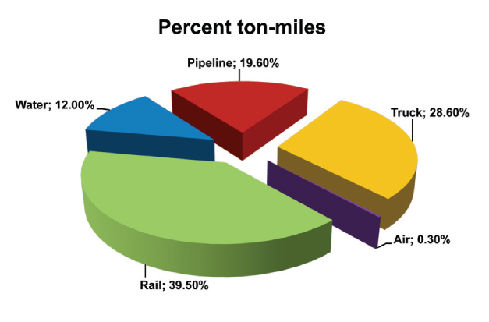
Freight is moved by rail, water, pipeline, truck, and air The rail network accounts for 40 percent of U.S. freight moves by ton-miles (the length freight travels)

Slide 5
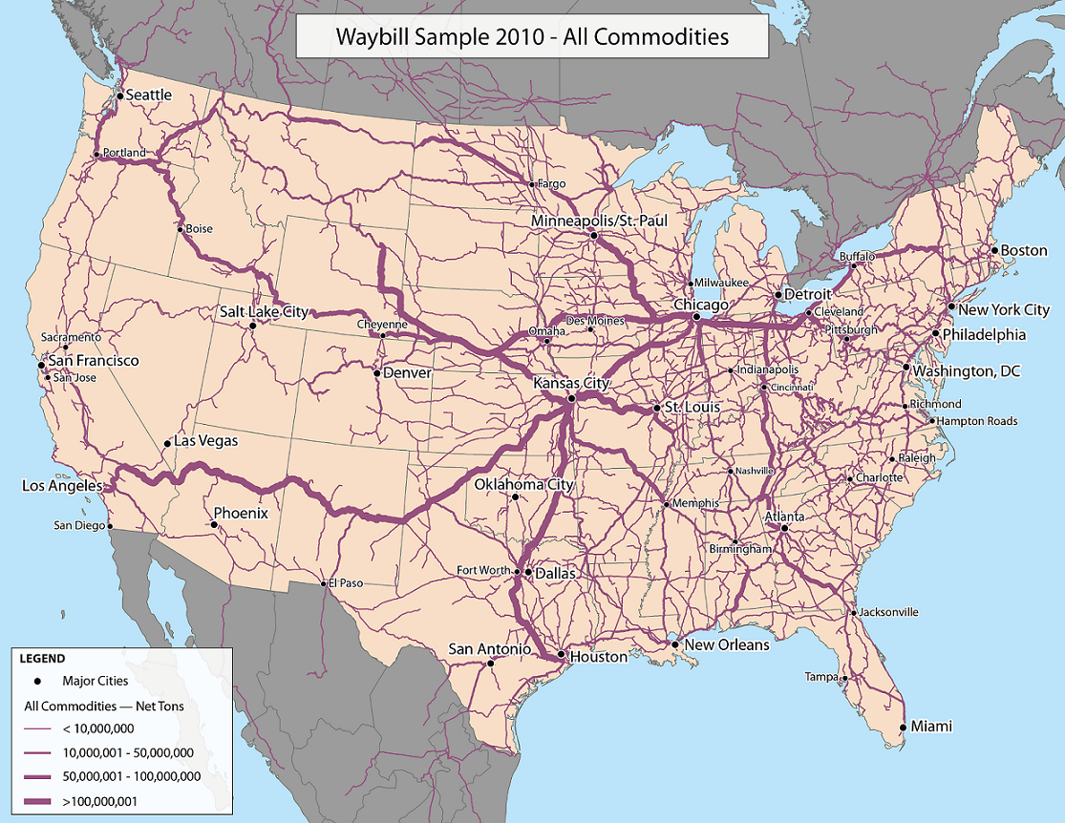
Each person in the U.S. requires the movement of approximately 40 tons of freight every year.

Slide 6
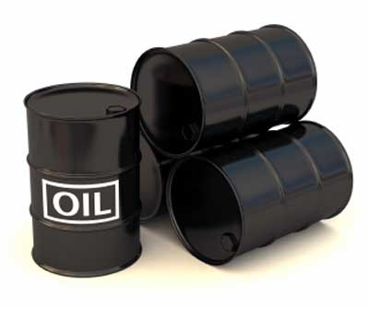
Rail shipments of crude oil have grown from a few thousand carloads a decade ago to 434,000 carloads last year, with projections to 600,000 a year by 2015

Slide 7
Don’t buy the argument that crude-by-rail disasters demonstrate the need for the Keystone XL pipeline. In fact, the two transport methods have very little to do with each other. The vast majority of crude moving by rail is moving east or west from shale sources, not the tar sands crude that Keystone XL would have shipped. Oil producers have rejected proposed pipelines because they prefer the flexibility of rail to sell their products to whichever market is paying the highest price.

Slide 8
The type of crude being transported may be more flammable than traditional heavy crude oil. In recent accidents, tank cars exploded with a force that surprised investigators. Refineries presently do not have the processing towers, known as stabilizers, that shave off flammable natural gas liquids (NGLs) from crude.

Slide 9
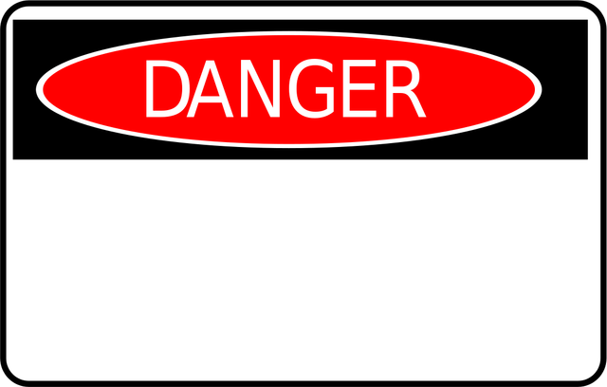
Blast Zone of Crude Oil Tank Car Trains
Each day, nearly 500 freight trains pass through the region
¼ of the nation's freight rail traffic, handling 37,500 railcars
Each of the cars can spend from 10 to 30 hours
traversing the Chicago region, and switched at any one of
the 21 yards

Slide 10
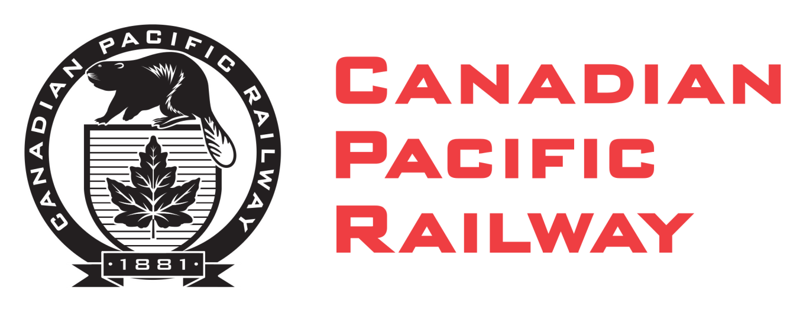
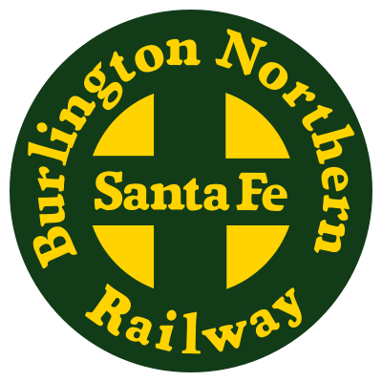
6 of the 7 largest rail carriers access the region: the eastern railroads, Norfolk Southern (NS) and CSX; the western railroads, BNSF Railway (BNSF) and Union Pacific (UP); and the two Canadian railroads, Canadian Pacific (CPR) and Canadian National (CN).

Slide 11
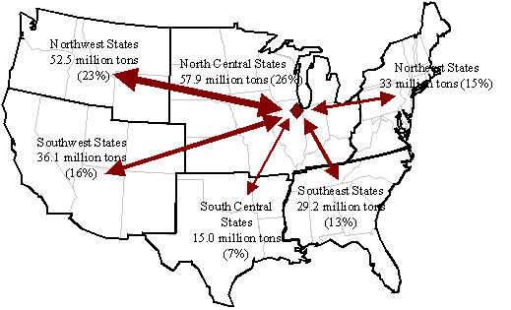
5 Corridors in/out - through Chicago Central, Beltway, Western Ave, East-West, Passenger Express The volume of goods transported via rail to, from, or through Chicago is forecast to increase nearly 150 percent between 2010 and 2040.

Slide 12
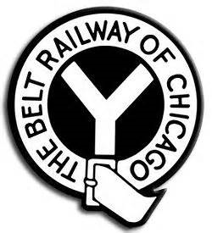
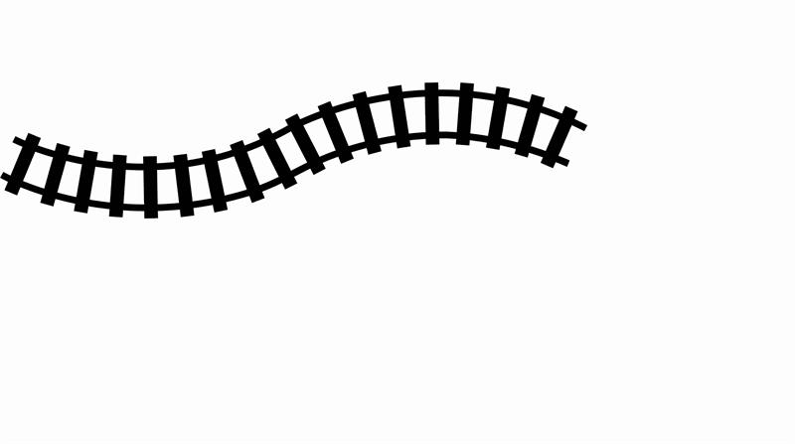
The state is served by 47 common freight carrier railroads, and 10 private freight carriers.
There are 25 major “junctions” where trains headed in
different direction, on different railroad, will regularly meet.
In addition, 760 passenger
trains pass through the
region every day.

Slide 13
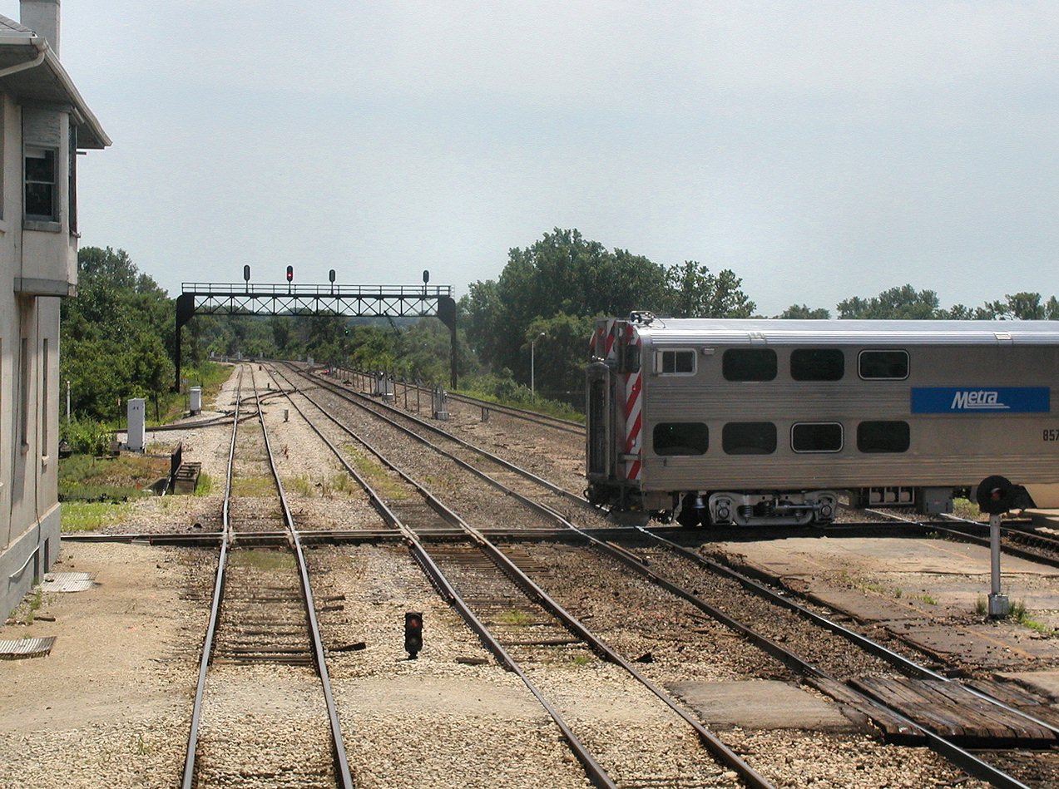

Slide 14
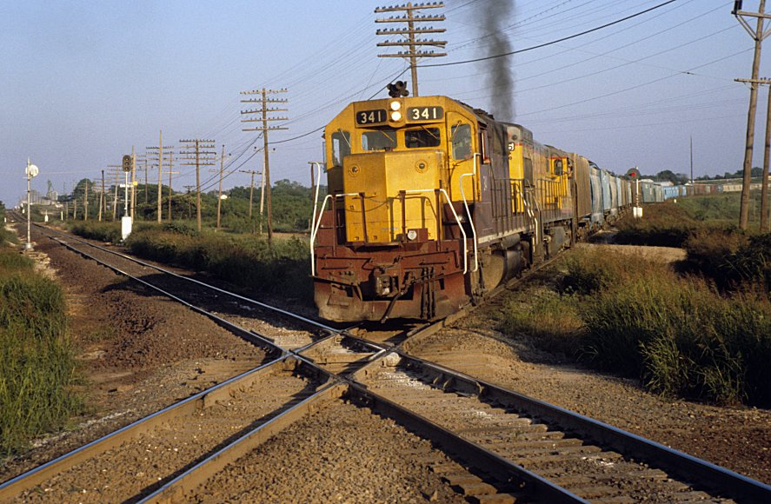

Slide 15
The rail lines built more than a century ago in Chicago were not configured for the volumes / types of freight being carried currently

Slide 16
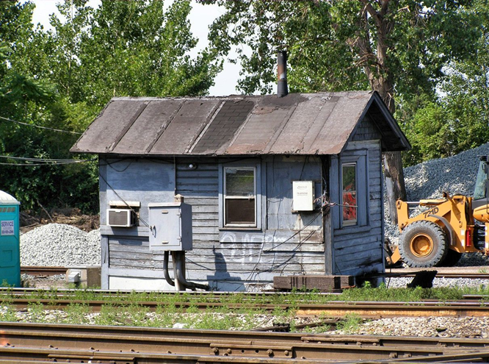
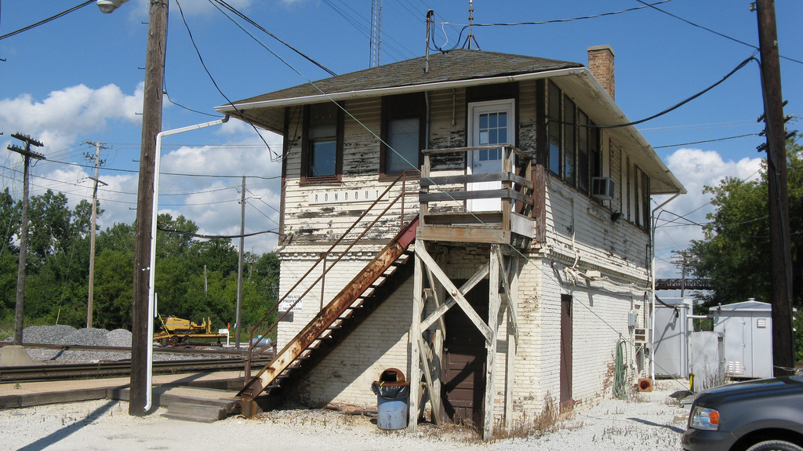
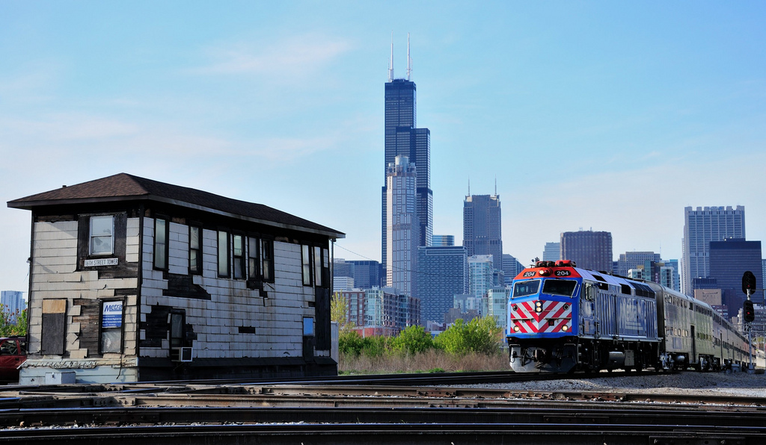

Slide 17
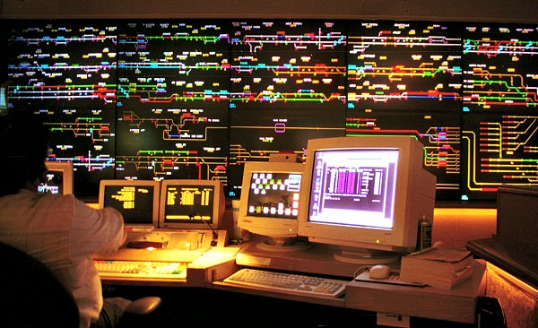
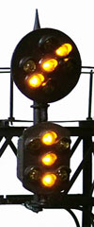
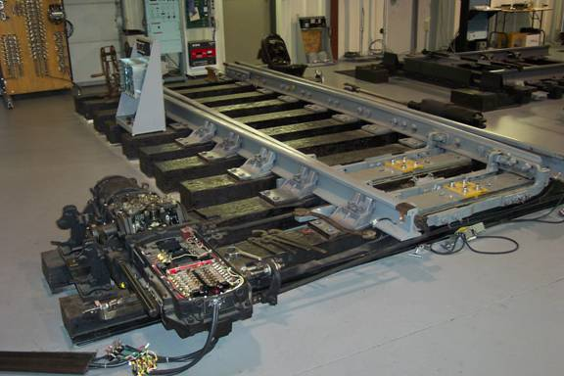
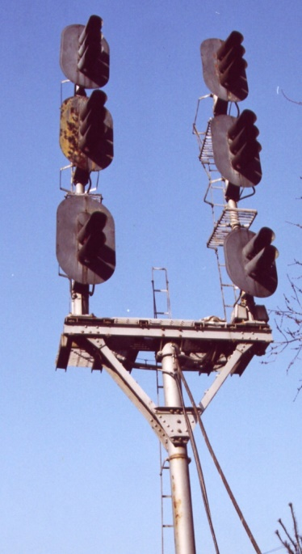

Slide 18
Does a crude oil tank car train pass by my house, or go through my neighborhood?

Slide 19
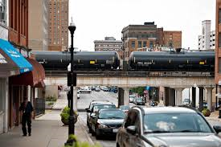
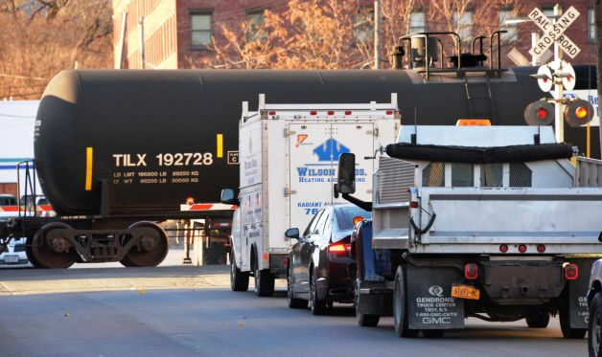
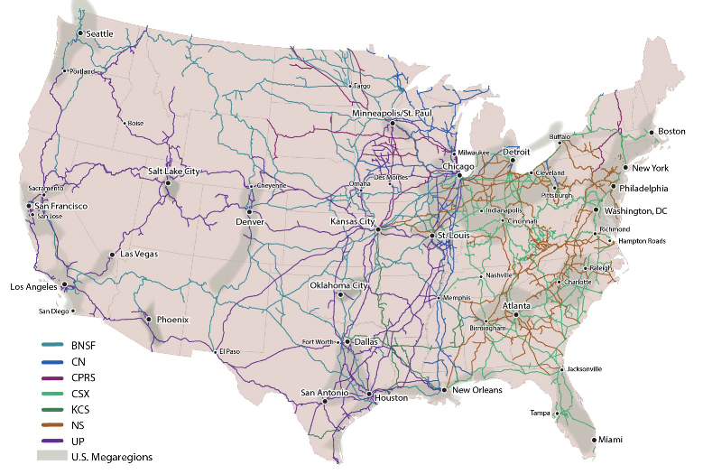
The U.S. is becoming a more urbanized country. It is forecast that 75% of U.S. inhabitants will live in these areas.

Slide 20
30 trains a week travel through Kane, DuPage and Cook counties on the BNSF - through suburbs from Aurora and Naperville to Cicero and into Chicago Canadian National runs 5 to 7 crude oil trains a week through Will, Cook and DuPage counties An average of 4 Canadian Pacific crude oil trains pass through Lake, Cook and DuPage counties weekly The Union Pacific reported up to 2 trains a week through Cook and Will counties Trains are turned over in Cook County to CSX Transportation and Norfolk Southern railroads and continue to east coast refineries
40 crude oil trains roll through the Chicago area weekly

Slide 21
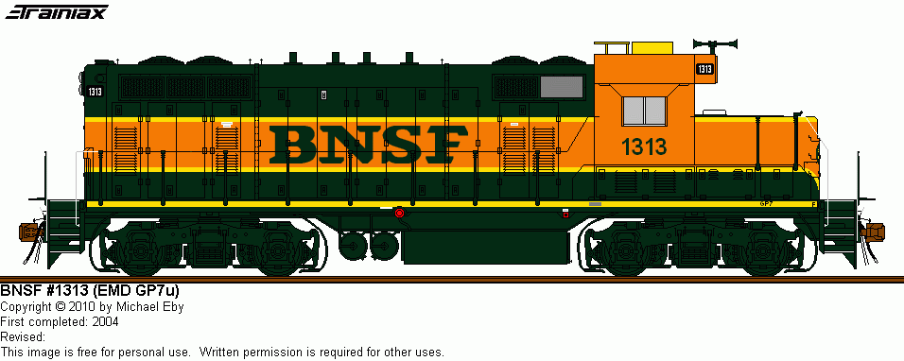
There is no legal limit to the length of train. "Helper" engines can be added at the rear of a train, and enable increasing the length. Super freight trains, although not common, can extend about 3 1/2 miles.

Slide 22
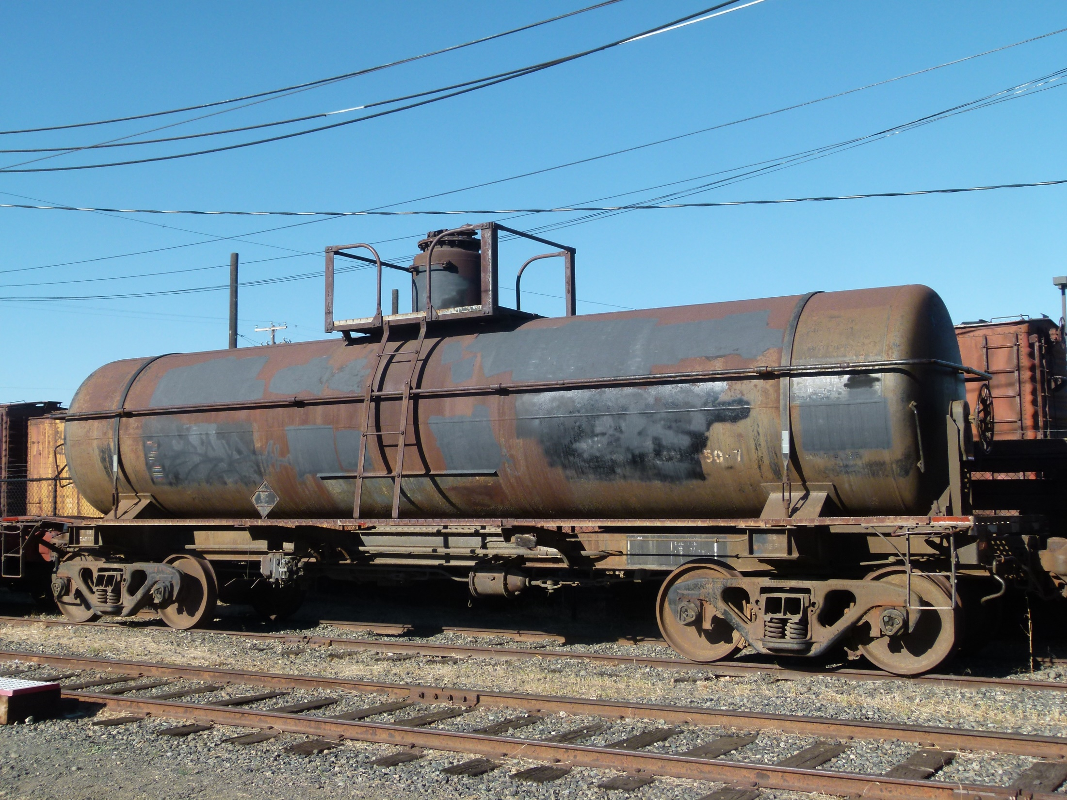

Slide 23
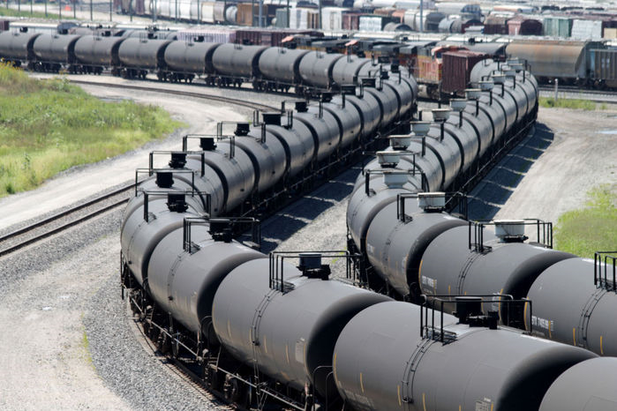
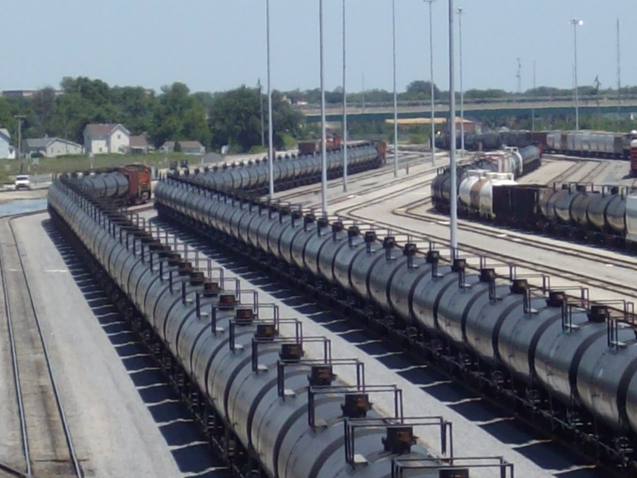
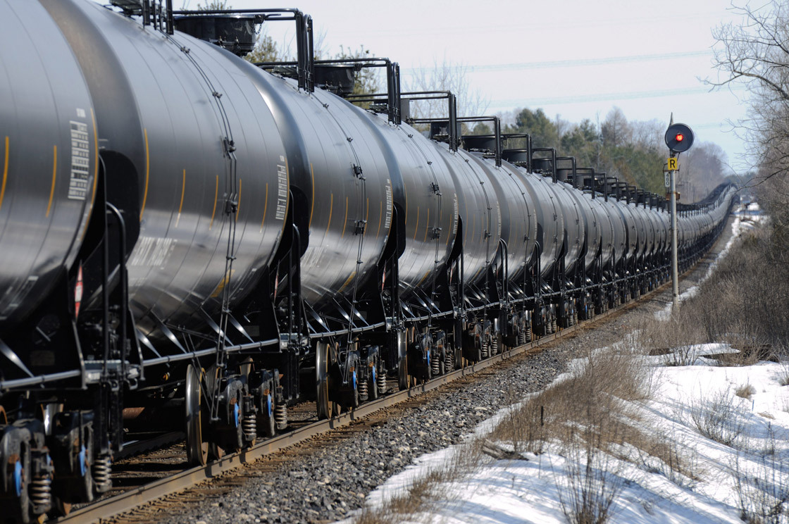
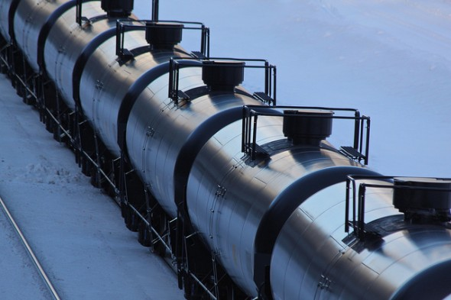

Slide 24
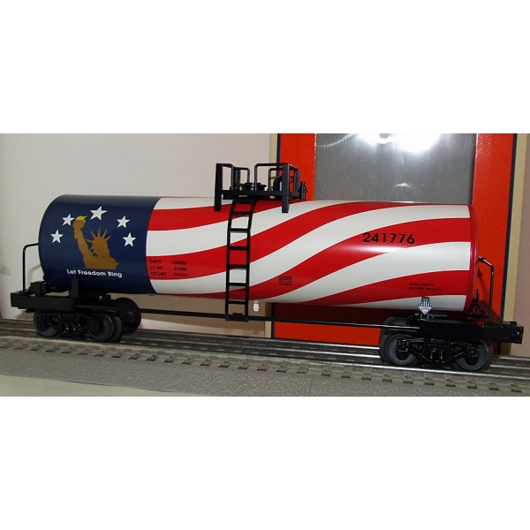
The Staggers Act of 1980 deregulated the American railroad industry

Slide 25
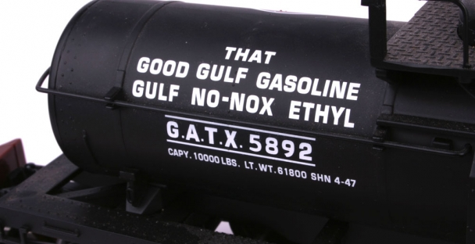
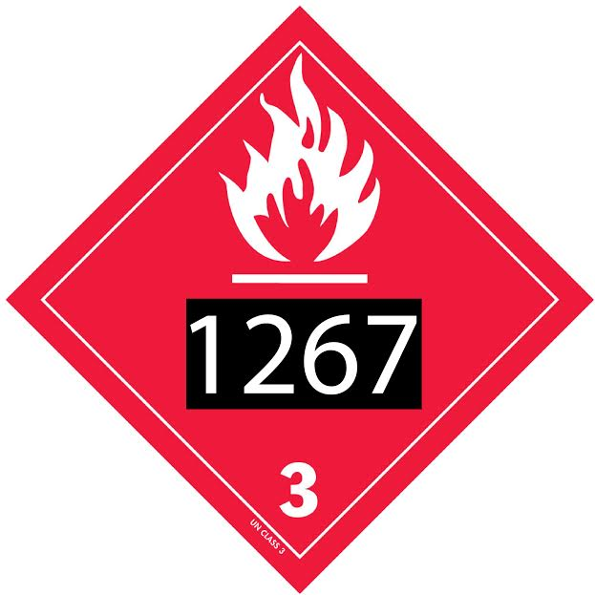
Tanks cars have a plate thickness of only 7⁄ 16 inch, with a capacity of carrying 34,500 US gallons of oil. Much of the oil is being hauled by an old fleet of some 78,000 tank cars lacking safety features.

Slide 27
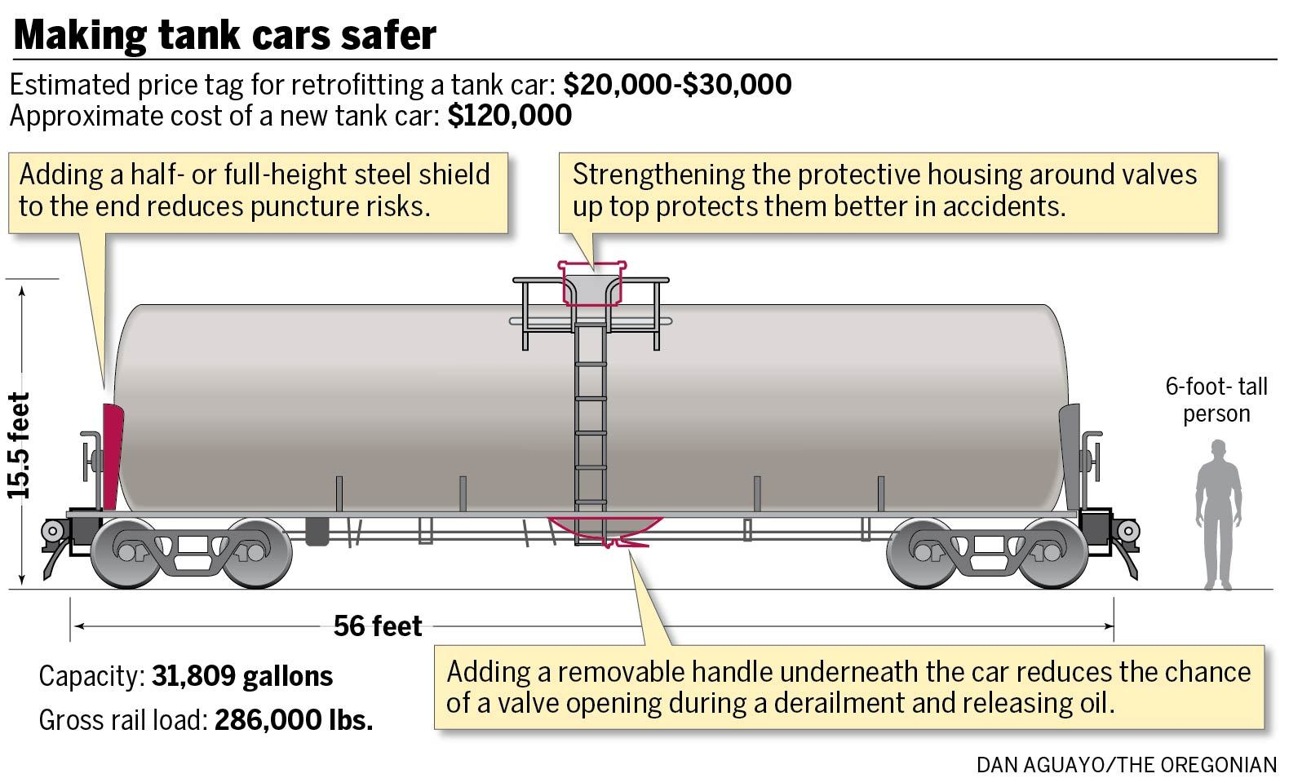

Slide 28
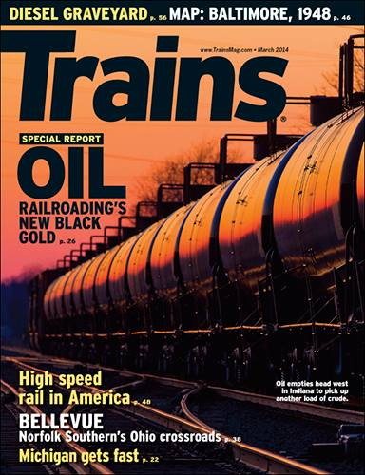
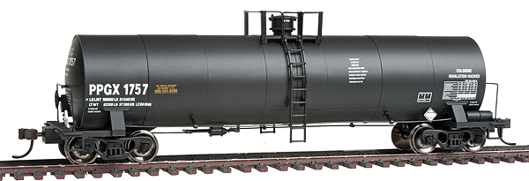
More than 1 million barrels
of crude oil move by train
across the U.S. every day
Notes:
Articles on website

Slide 29
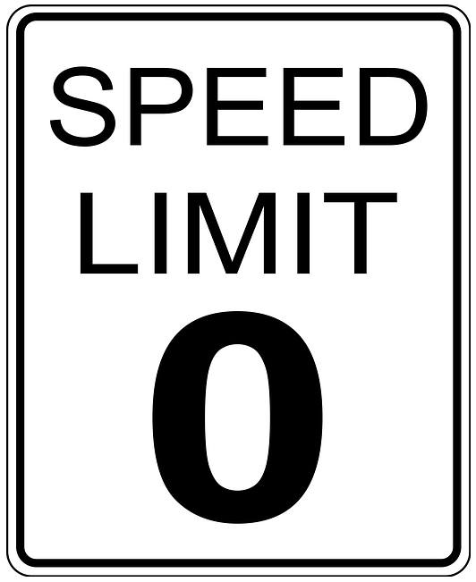
Maintenance of Way Federal track safety standards allow 19 out of 24 crossties to be defective along any 39-foot stretch of the lowest grade of track, where the speed limit is 10 m.p.h. On the best of tracks, which have a speed limit of 80 m.p.h., the standards allow half of the crossties to be decayed or missing.

Slide 30
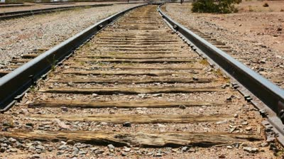
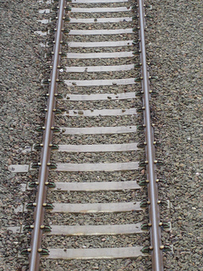
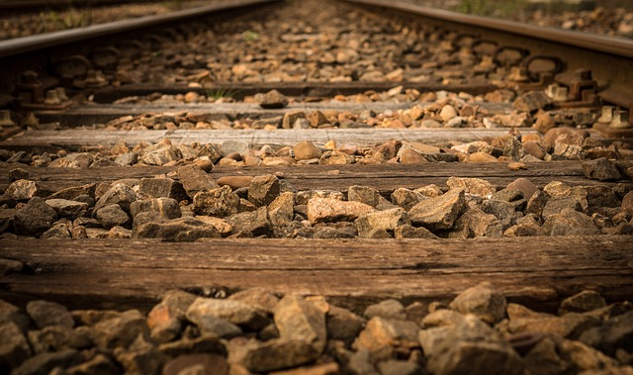
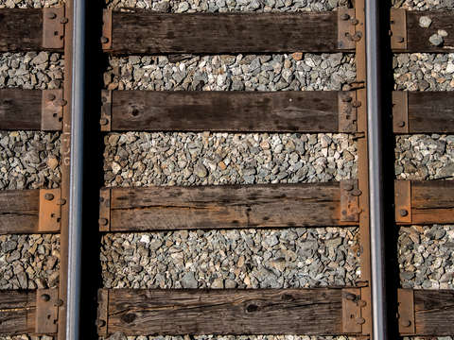

Slide 31
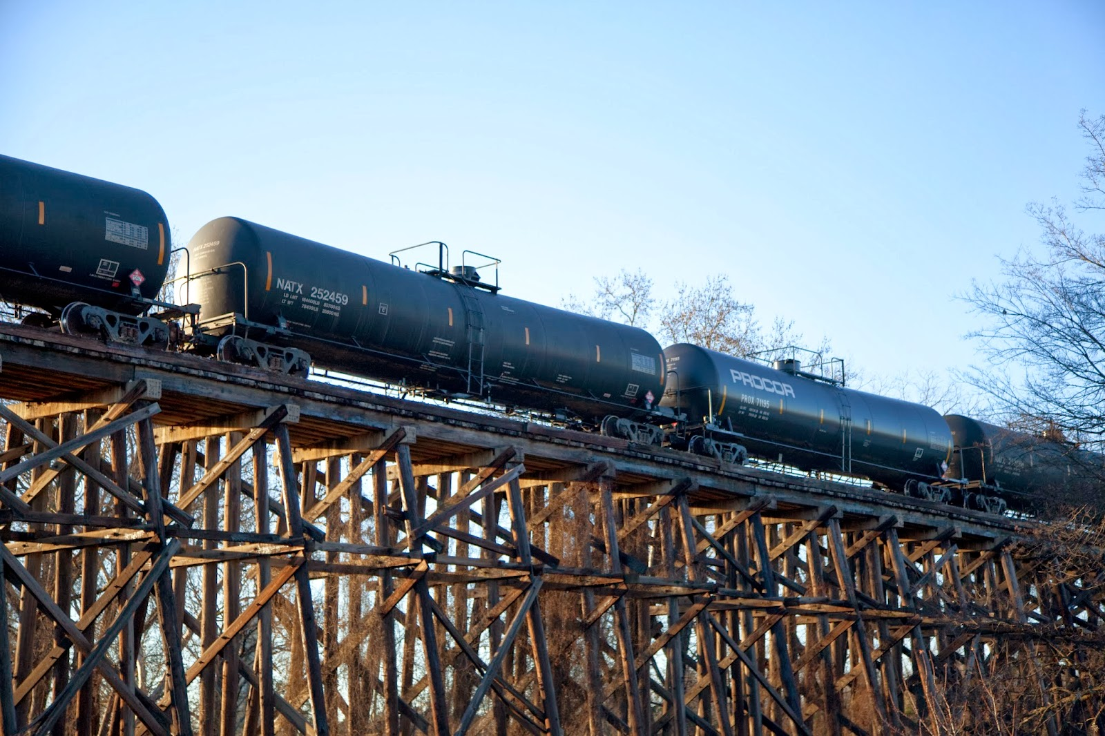

Slide 32
Speeds in excess of 25 mph “irresponsible” given known weaknesses of tank cars Slower speeds can cause a sloshing effect in tank cars, with rolling stock wobbling off the tracks

Slide 33
10 Accidents a Year Anticipated

Slide 34
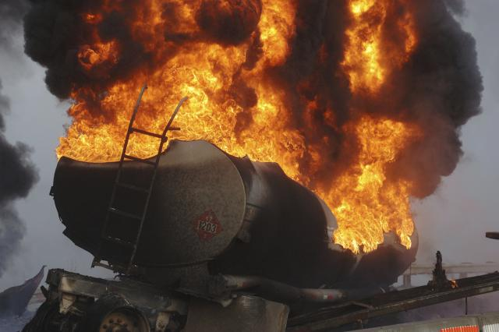

Slide 35
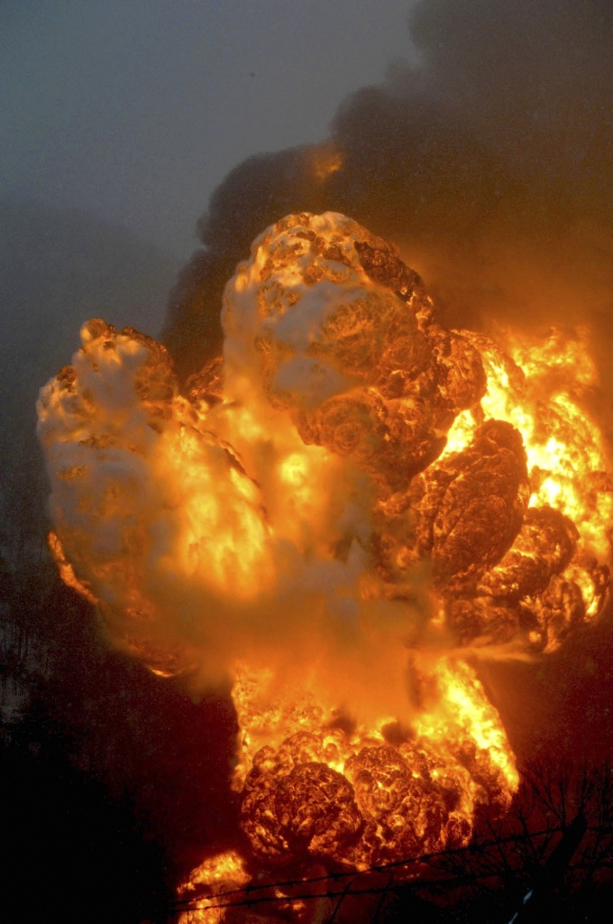

Slide 36
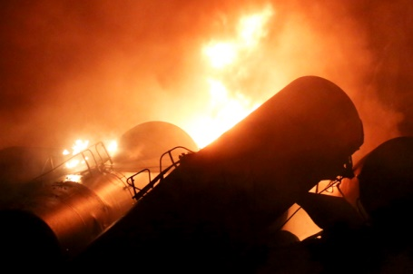

Slide 37
Current Estimate: Average of 15 Trains Loaded Each Day For Round Trips of 3,200 miles Traveling 17,500,000 Train-Miles Through the US each year

Slide 38
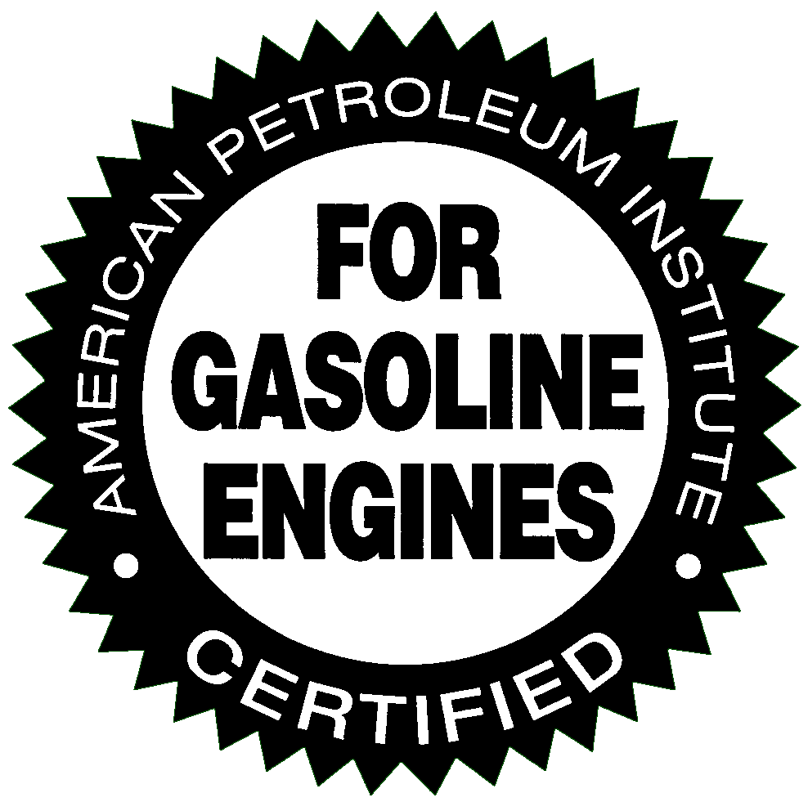
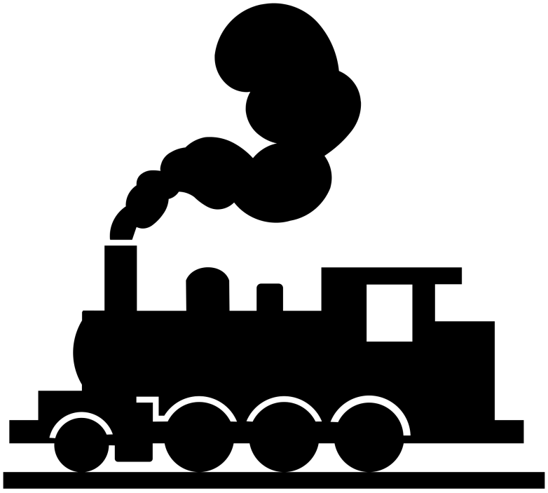
Stakeholders:
American
Petroleum
Institute
American
Association of
Railroads

Slide 39
FRA Federal Railroad Administration DOT The oil and railroad industries are urging federal regulators to allow them as long as 7 years to upgrade existing tank cars. The proposals included an upgrade in operating protocols, such as lower speed limits, more track inspections, and better emergency response training.
Aldermen
Mayors
Governor
State Reps
US Congress

Slide 40
ChiOilbyRail
ChiOilbyRail

Slide 41
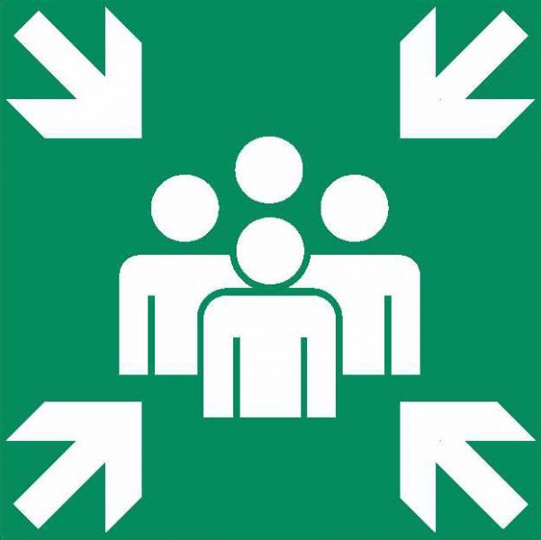
Chicago Greens www.illinoisgreens.org Monthly Meetings 2nd Sunday of Each Month 2-4:00 PM Powell’s Bookstore Halsted and Roosevelt (800 W, 1299 S)

